Slide 1

F u t u r e V e h i c l e E d u c a t i o n W o r k s h o p
Subject: Arduino
Automation Lab.

Slide 2
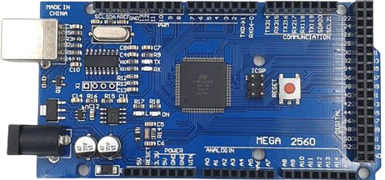

Introduction
Arduino mega 2560
→ Ultra-compact computer to control multiple devices and sensors
Digital I/O Pins (PWM) _{Communication Pin}
USB
Connector
Digital I/O Pins
Automation Lab
Power Pin
Analog Input Pins
2

Slide 3
Introduction
Arduino mega Pin Description
Power Pins: Pins used to power devices connected to Arduinos
(+) Power: 5V or 3.3V, VIN
(-) Power: GND
Digital I/O Pins: Pins that read or send digital signals of 0(LOW) or 1(HIGH)
Analog input pin: Pin that reads analog signal with an integer value between 0~1023
Digital Input/Output (PWM) Pins: Convert digital signals like analog signals, 0~255 values
USB connector: connector used to communicate with the PC, upload the Arduino program

Slide 4
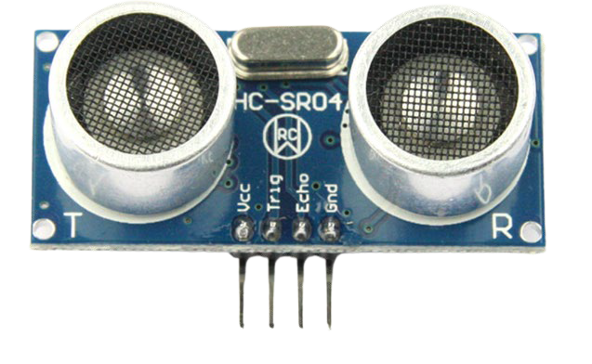
Introduction
Ultrasonic Sensors
→ Sensors that use ultrasound to recognize the distance to an object located in front of it
Trig
Echo
Vcc Trig Echo Gnd (5V)

Slide 5
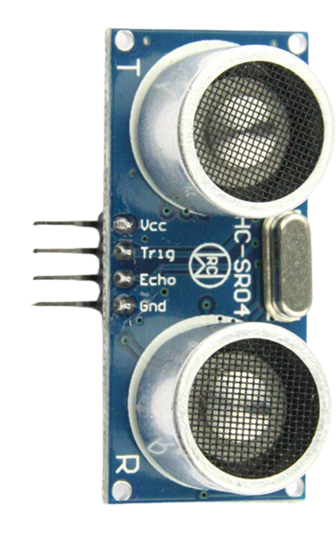
Introduction
Ultrasonic Sensor Description
The ultrasound wave is sent from the transmitter (Trig) and then reflected and returned is recognized by the receiver (Echo)
Calculate the distance by measuring the time it took from transmission to reception of ultrasound
((340 * duration) / 1000) / 2
Trig
Echo
Automation Lab
물체
5

Slide 6
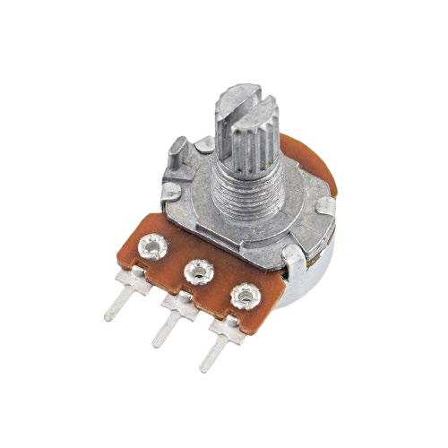
Introduction
Variable Resistance
→ Resistance that can change the value of the current flowing through the circuit
→ Output the strength of the resistor as an analog value via the Output pin
Sweepe
r
1(GND)
2
(output)
3(5V)

Slide 7
Introduction
Variable Resistance Description
→ Move the sweeper to determine the resistance strength of the variable resistance
→ Turn the sweeper to the side connected to 5V to output the maximum value, and turn the sweeper to the side connected to GND to output the minimum value
Rotate to 5V to the maximum
스위퍼
Gnd 5V
Output
<Output minimum value (0)>
Gnd 5V
Output
<Output maximum value (1023)>

Slide 8
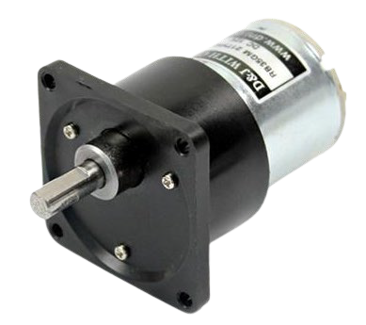
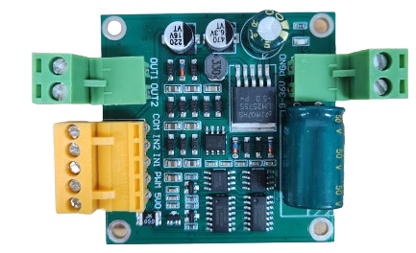
Introduction
Gear Motor & Motor Driver
→ Motors designed to generate high torque
→ Motor driver for motor power supply
Power
Motor Power
( - )
( + )
Gear Motor(12V)
Motor Control
Motor Driver

Slide 9



Introduction
Motor Driver Control Description
COM Pin: Connecting with Arduino's GND
PWM Pin: Connects with Arduino's 5V
IN1, IN2 pins: Determining the direction of rotation of the motor, connecting to the digital pins Connects to PWM pins for speed control
IN1 | IN2 | output
0 | 0 | stop
1 | 0 | Forward rotation
0 | 1 | Reverse rotation
Motor Control
Motor Driver

Slide 10
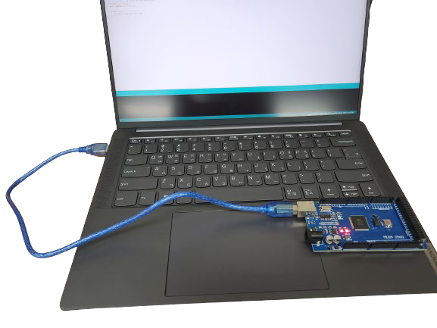
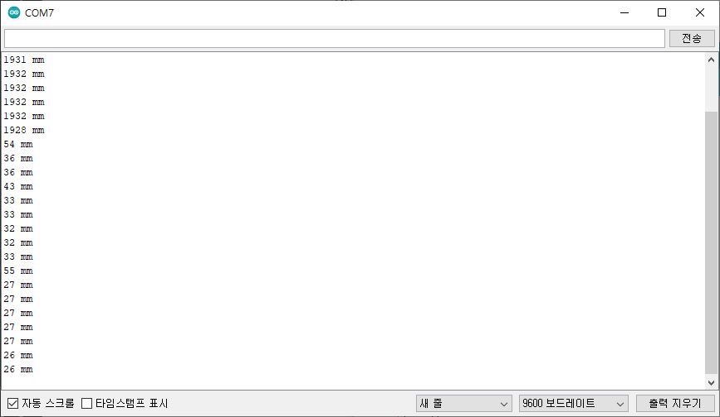
Introduction
Serial Communication
→ How Arduino communicates with your PC
→ It is possible to transmit or receive data with Arduino.
USB connection to PC (laptop)
<Serial Monitor Screen>

Slide 11
Exercise
Embedded System Lab.

Slide 12

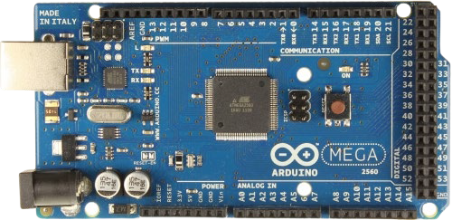
1. Hardware Setting
Arduino Hardware Setting
→ Must be preceded by software setup
→ Connect the USB cable directly to the USB port on your laptop (PC)
Arduino board
Notebook(PC)

Slide 13
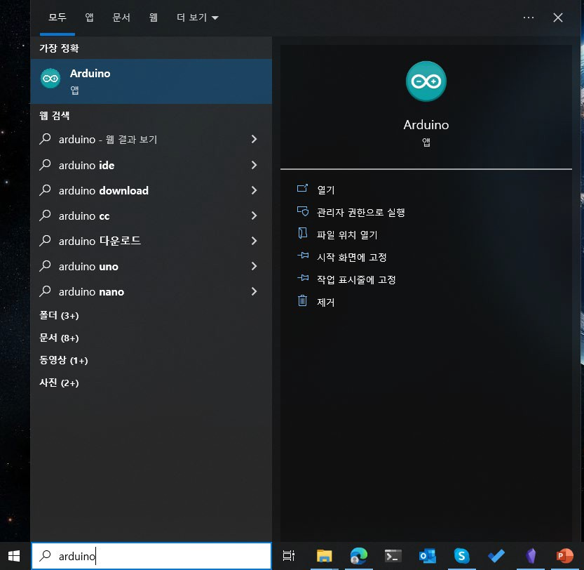
2. Software Setting
Launch the Arduino app
→ Type "Win key+q" on your keyboard, then type "arduino" and click "Open"
→ To install the app, refer to the “Environment Setting" material!

Slide 14
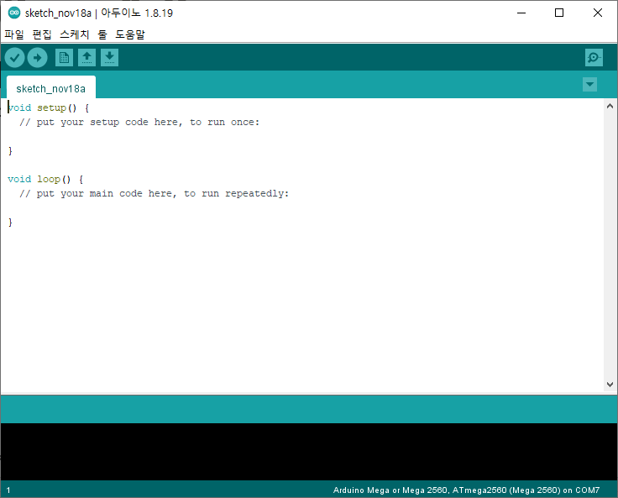
2. Software Setting
Arduino app initial screen

Slide 15
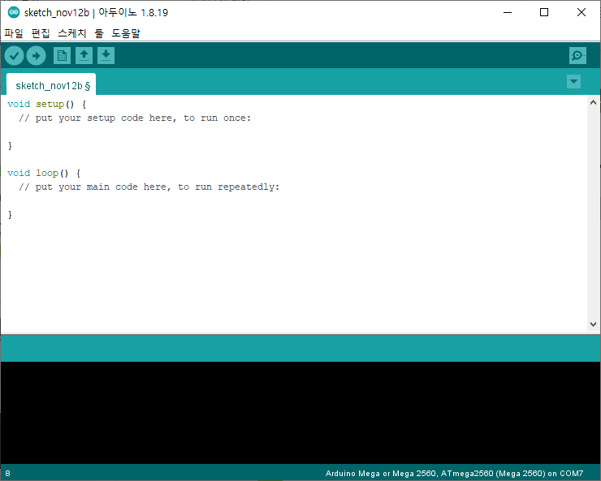
2. Software Setting
Add a library
→ Click "Sketch"

Slide 16
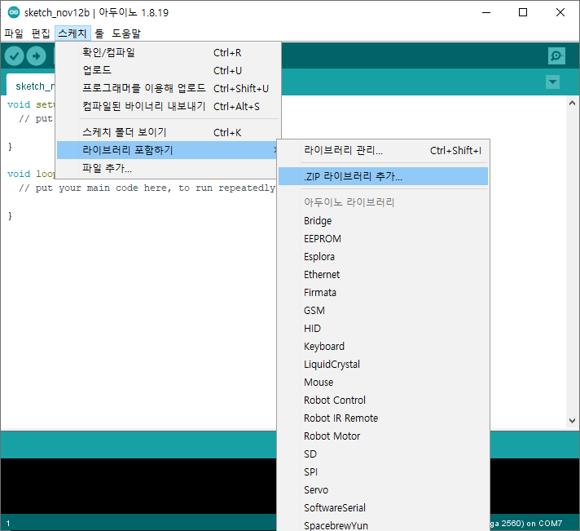
2. Software Setting
Add a library
→ "Embed a library"-> Add .ZIP libraries… Click

Slide 17
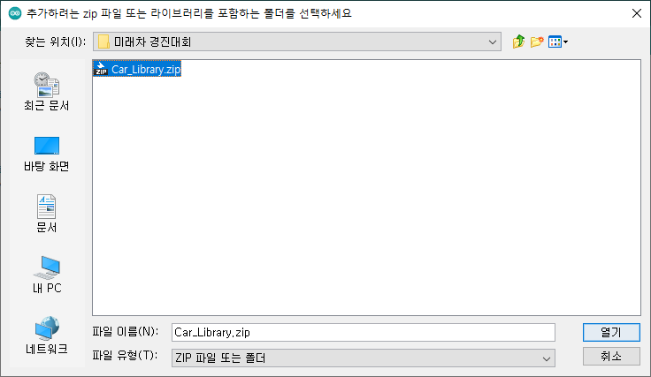
2. Software Setting
Add Library
→ When that window appears, select the "Car_Library" compressed file downloaded from Github and click "Open"

Slide 18
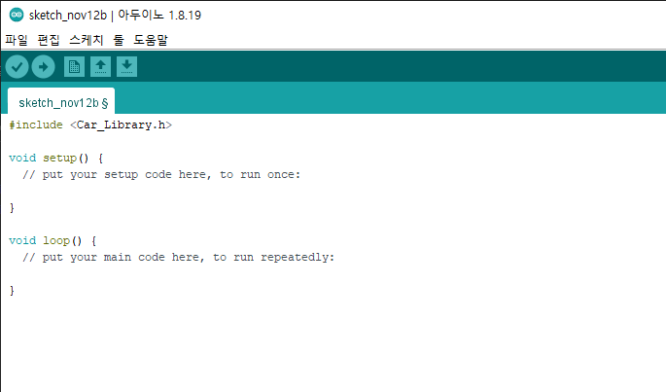
2. Software Setting
Add a library
→ Enter "#include <Car_Library.h>" at the top of the source code

Slide 19
2. Software Setting
Board Settings
→ After launching the Arduino app, click "Tools"

Slide 20
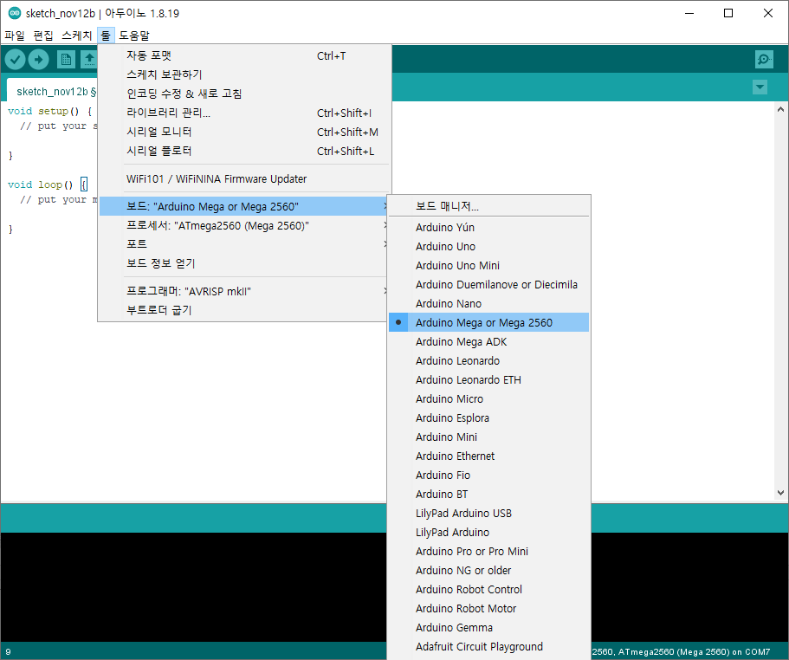
2. Software Setting
Board Settings
→ Tool -> Board -> Select “Arduino Mega or Mega 2560”

Slide 21
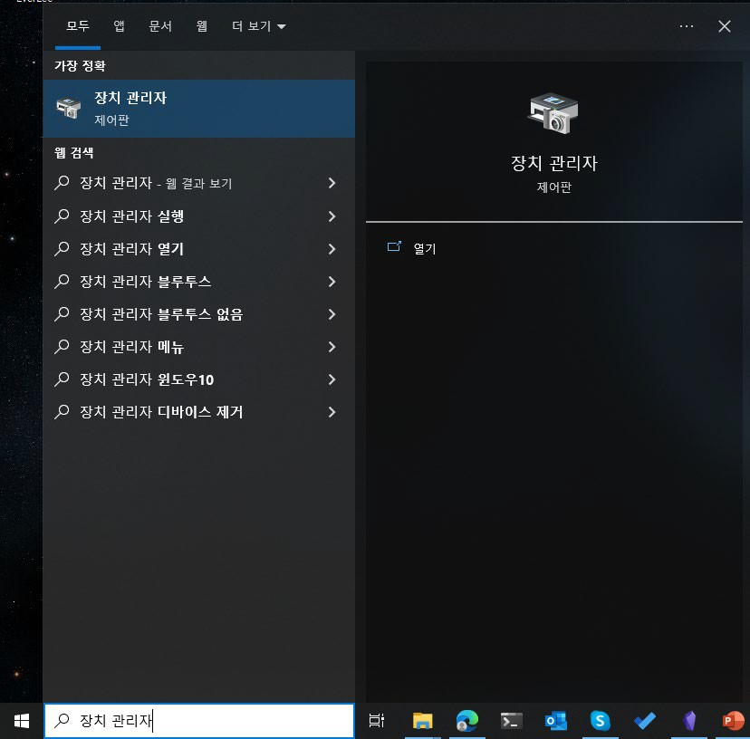
2. Software Setting
Serial Connection
→ Type "Win key+q" on your keyboard, then type "Device Manager" and click "Open"
→ Arduino and PC must be connected

Slide 22
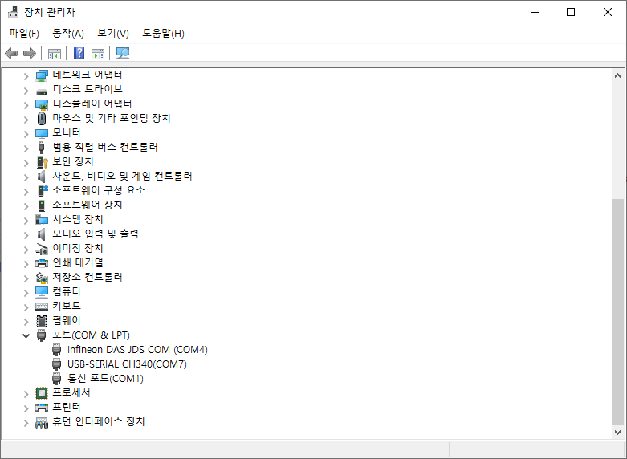
2. Software Setting
Check the serial port number
→ Device Manager - > Ports (COM & LPT) - > Check USB-SERIAL Port Number (COM*)
→ The number may change if you plug the USB cable into a port other than the one you originally plugged it in

Slide 23
2. Software Setting
Serial communication connection
→ After launching the Arduino app, click "Tools"

Slide 24
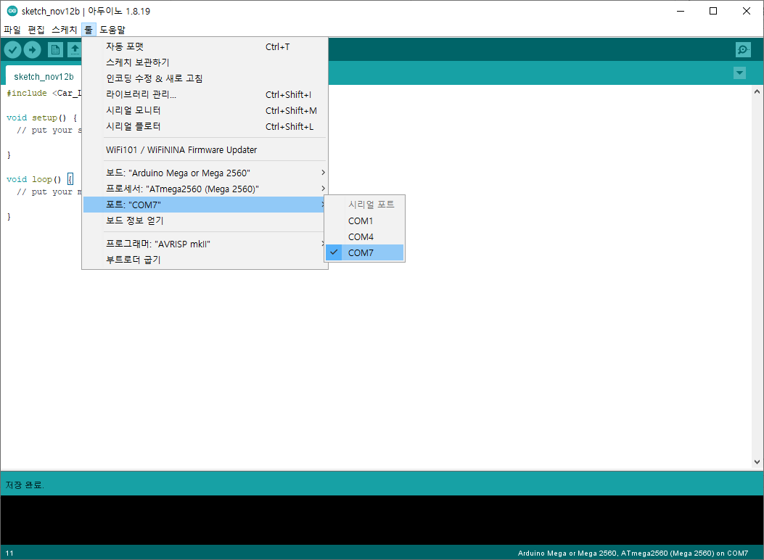
2. Software Setting
Serial Port Settings
→ Tools -> Port -> Select the port number that you check before

Slide 25
Exercise 1

Slide 26
Exercise 1
Measuring distances with ultrasonic sensors
→ Uses ultrasonic sensors to measure the distance to objects located in front of you
→ Output measured distance to serial communication
초음파 센서
결과 화면

Slide 27
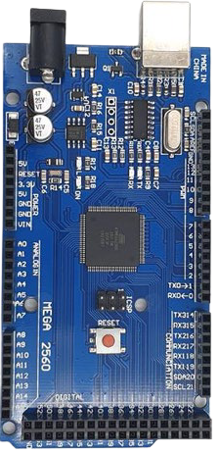
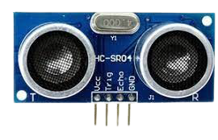


Exercise 1
Line connection
PWM Pin
Ultrasonic Sensors
Arduino board

Slide 28
Exercise 1
Line connection (Cont’d)
→ Ultrasonic sensor VCC – connected to Arduino 5V
→ Ultrasonic sensor GND – connected to Arduino GND
→ Ultrasonic sensor Trig – Arduino PWM connected to pin 3
→ Ultrasonic sensor Echo – Arduino PWM connected to pin 2

Slide 29
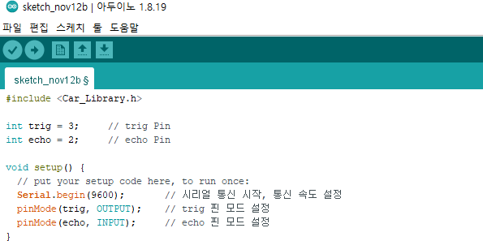
Exercise 1
Declaring a Pin Number Variable
→ Trig of ultrasonic sensor, declaration of the Arduino pin number variable linked to echo

Slide 30
Exercise 1
Serial Communication and Pin Mode Settings
→ Start serial communication and set the mode of the connected pin

Slide 31
Exercise 1
Function description
Serial.begin(Communication speed)
→ Start serial communication at the input communication speed
pinMode(Pin Number, mode)
→ Set the mode of the pin you entered.
→ Can be set to OUTPUT or INPUT
→ In that example, trig sends ultrasonic waves, so OUTPUT, Since echo receives reflected ultrasound, it is set to INPUT

Slide 32
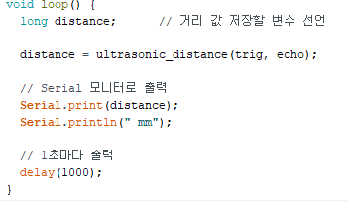
Exercise 1
Variable declaration and running distance measurement functions
→ Declaring a variable to store the distance value, running the ultrasonic sensor distance measurement function

Slide 33

Exercise 1
"ultrasonic_distance()" explained
→ Function to measure the time taken to receive and calculate the distance after ultrasonic transmission
①
②
① Input: Enter the number of the connected trig pin and echo pin
② Output: Output calculated distance (mm)

Slide 34
Exercise 1
Output of measurements
→ Output measured distance values to serial monitors

Slide 35

Exercise 1
Function Description
Serial.print(data)
→ Output data via serial monitor if you want to output a → string, use double quotes ("")
→ Serial.println() is a function that wraps the line after outputting the data.
Delay(time)
→ A function that stops Arduino's operation for as long as the input is received
→ units are milliseconds, ms (1/100th of a second)

Slide 36
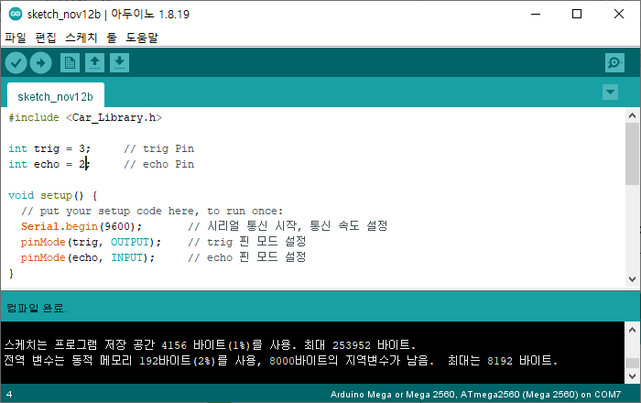
Exercise 1
Compile and Upload
→ After you finish writing the source code, click the OK button to confirm the compilation and compilation completion.
→ If you get a window asking you to save, you can save or cancel it

Slide 37
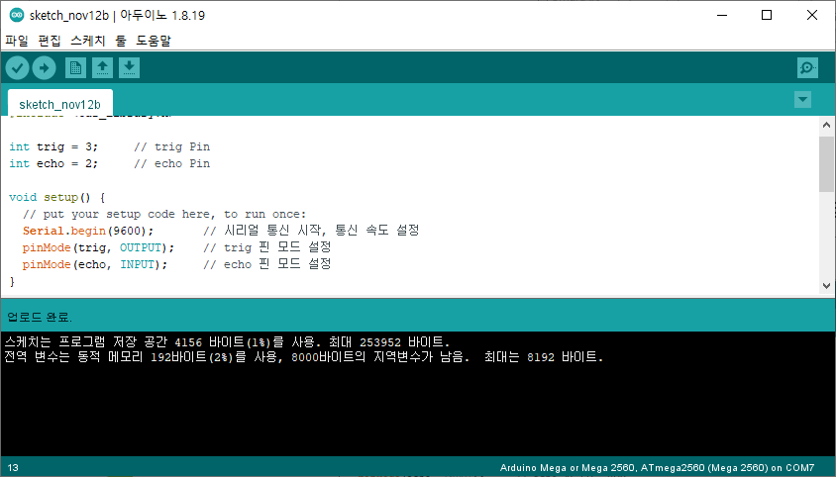
Exercise 1
Compile and Upload
→ Click the upload button to upload to Arduino board and confirm upload completion

Slide 38
Exercise 1
Check the results with the serial monitor
→ Click the Serial Monitor button or type "Ctrl + Shift + m"

Slide 39
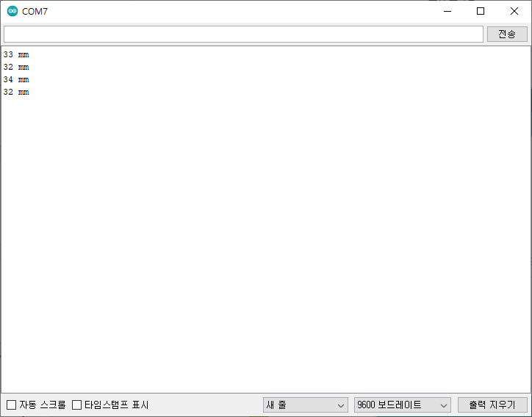
Exercise 1
Serial Monitor Window

Slide 40
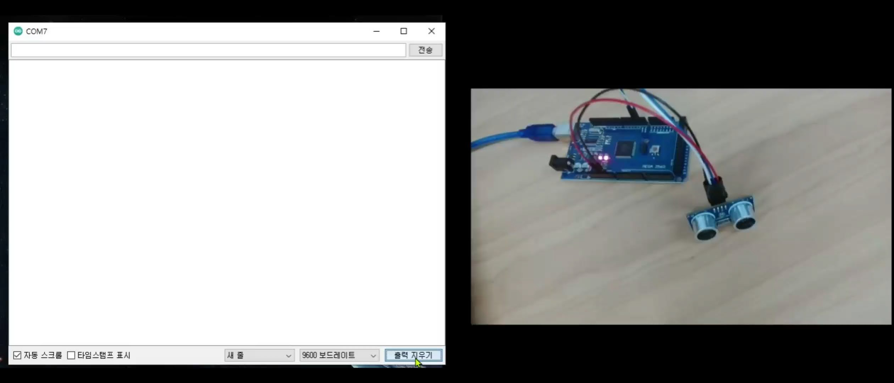
Exercise 1
Check the results with the serial monitor
→ Check the distance value output

Slide 41
Exercise 2

Slide 42
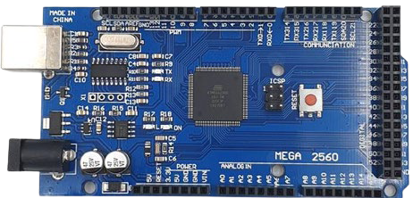
Exercise 2
LED brightness control using variable resistors
→ Adjustable LED brightness with analog input using variable resistor
Variable Resistance
Built-in LED

Slide 43


Exercise 2
선 연결
Analog Input Pins
Variable Resistance
Arduino board
Output
①
③

Slide 44
Exercise 2
Line connection(Cont’d)
→ Variable Resistor Pin 1 – Connects to Arduino GND
→ Variable Resistance Pin 3 – Connected to Arduino 5V
→ Variable Resistor Output – Connected to Arduino Analog A5 Pin

Slide 45
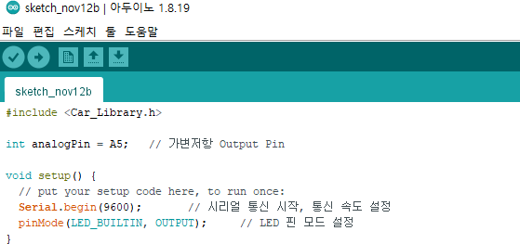
Exercise 2
Declaring a Pin Number Variable
→ Declaration of Arduino Pin Number Variable Linked to Variable Resistor Output Pin

Slide 46
Exercise 2
LED Pin Mode Settings
→ Setting the Variable Resistor Pin Mode Connected to the Arduino

Slide 47
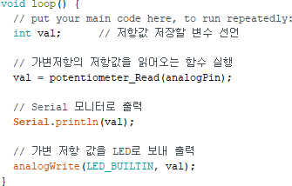
Exercise 2
Running a function that reads variable declarations and resistance values
→ Declare a variable to store the resistance value, and execute a function that reads the resistance value of the variable resistor

Slide 48

Exercise 2
“potentiometer_Read()” description
→ A function that reads the resistance value of a variable resistor
①
②
① Input: Input the pin number associated with the output pin of the variable resistor
② Output: Output resistance value mapped to 255

Slide 49
Exercise 2
Resistive value serial output and LED output
→ Output the resistance value of the variable resistor to the serial monitor
→ Send the resistor value to the LED to adjust the brightness

Slide 50
Exercise 2
Function Description
analogWrite(Pin num, value)
→ Set the output voltage of the pin to the input value (0~255)

Slide 51
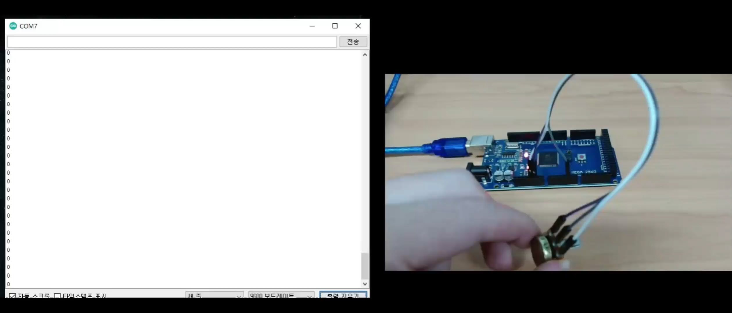
Exercise 2
Check LED Brightness Control
→ Check LED brightness control with variable resistors

Slide 52
Exercise 3

Slide 53
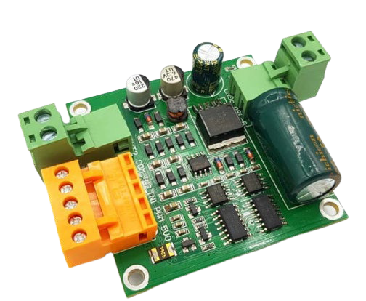
Exercise 3
Motor Control
→ Connect the motor driver and gear motor to the Arduino to control the motor
Gear Motor
Motor Driver

Slide 54
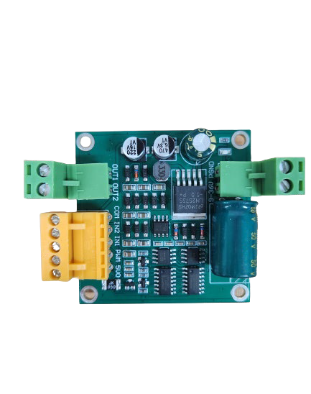
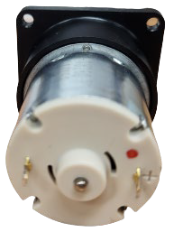



Exercise 3
Line connection– ①Motor Driver:Gear Motor
→ Gear motor red marked part – connected to motor driver OUT1
→ Gear Motor Unmarked Part – Connected to Motor Driver OUT2
Motor Output
Motor Driver
Gear Motor

Slide 55


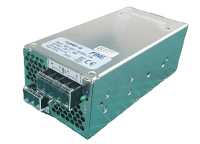
Introduction
Line connection- ② Motor Driver:Power Supply
→ Requires 12V power because it uses a 12V motor
→ Power supply positive (+) – connected to the motor driver power portion 9-36 V portion → power supply cathode (-) – connected to the motor driver power portion PGND portion
( - )
( + )
Power
Motor Driver
Automation Lab
Power Supply

Slide 56




Introduction
Line connection- ③ Arduino:Motor Driver
PWM pin
Motor Control Unit
Automation Lab
Motor Driver
56

Slide 57
Introduction
Line connection- ③ 아두이노:모터 드라이버 (Cont’d)
→ COM of motor driver control unit– Arduino's GND Pin
→ PWM in the motor driver control unit– Arduino's 5V Pin
→ IN1 of motor driver control unit– Arduino's PWM Pin 3
→ IN2 of motor driver control unit– Arduino's PWM Pin 4

Slide 58
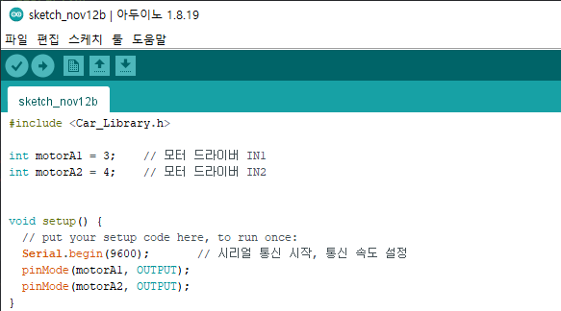
Exercise 3
Declaring Pin Variables
→ Declaration of the Arduino pin number variable associated with the driver's control pin

Slide 59
Exercise 3
Pin Mode Settings
→ Motor Control Pin Mode Settings

Slide 60
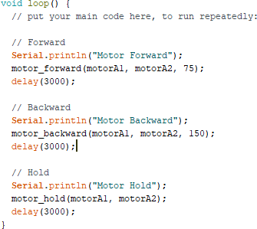
Exercise 3
loop() code

Slide 61
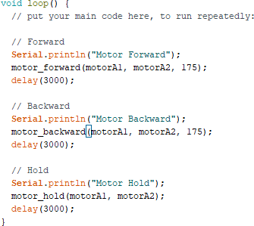
Exercise 3
Motor Forward Rotation
→ Run the "motor_forward()" function, enter the control pin number and motor speed

Slide 62

Exercise 3
“motor_forward()” description
→ Function to rotate the motor forward
①
②
① Input: Motor driver IN1, input pin number associated with IN2, motor rotation speed (0~255)
② The motor rotates at the input rotational speed in the forward direction

Slide 63
Exercise 3
Motor Reverse Rotation
→ “motor_backward()” Execute the function, enter the control pin number and motor speed

Slide 64

Exercise 3
“motor_backward()” description
→ Function to rotate the motor in reverse direction
①
②
① Input: Input the pin number and motor speed associated with the motor driver IN1 and IN2
② The motor rotates at the input rotational speed in the reverse direction

Slide 65
Exercise 3
Motor Stop
→ “motor_hold()” Run the function, enter the control pin number

Slide 66

Exercise 3
“motor_hold()” description
→ Function to stop the motor
①
②
① Input: Enter the pin number associated with the motor driver IN1, IN2
② Motor rotation stop

Slide 67
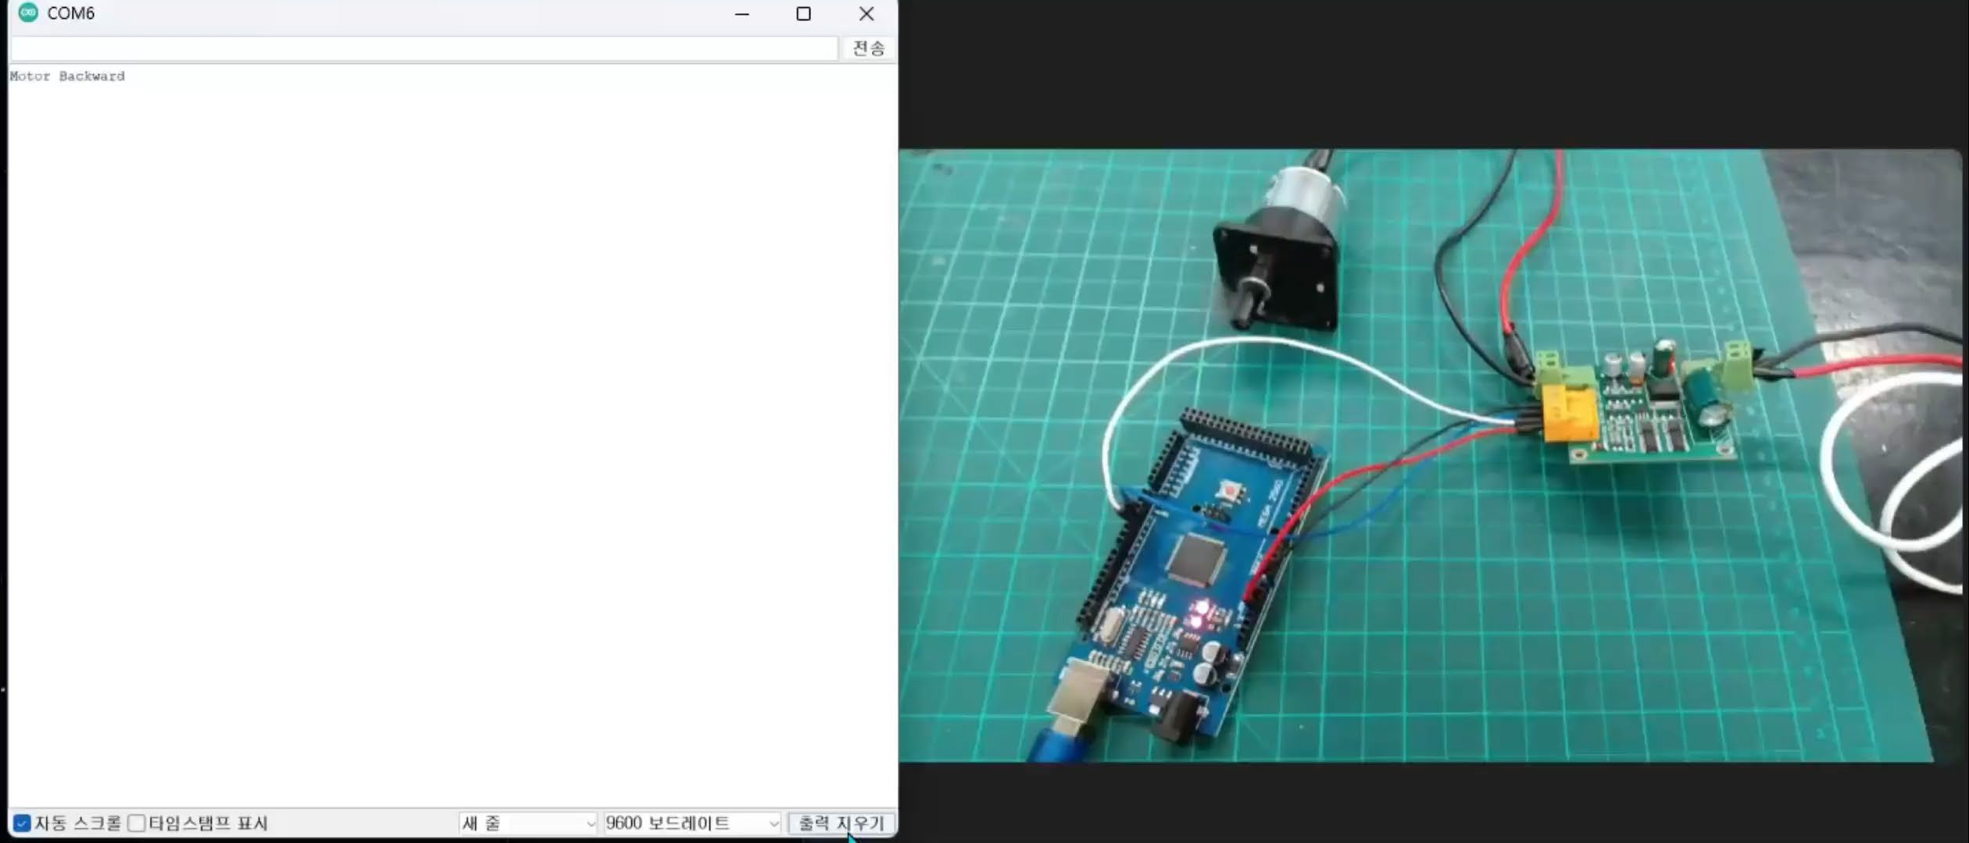
Exercise 3
Check the results

Slide 68
Exercise 4

Slide 69
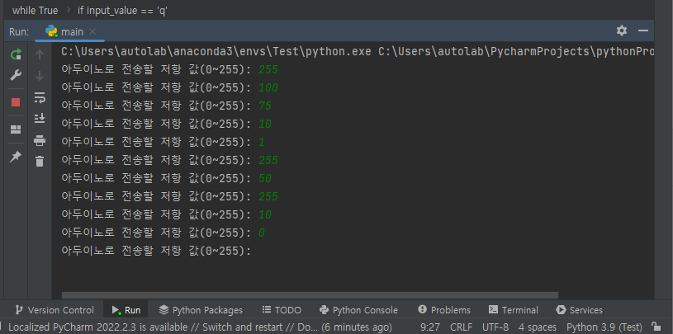
Exercise 4
Arduino control with a Python program using serial communication
→ Using serial communication, an integer value is sent to Arduino in a Python program to control LED brightness

Slide 70
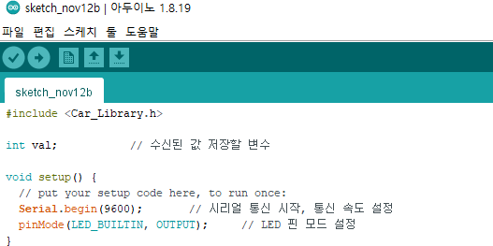
Exercise 4
Variable Declaration and Serial Communication Settings → Declare a variable to store the value sent to the serial

Slide 71
Exercise 4
Variable Declaration and Serial Communication Settings
→ Start serial communication and set communication speed, set LED pin mode

Slide 72
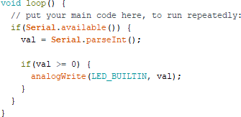
Exercise 4
Receive serial communication data
→ Read serial data and convert data to integers
→ Send the transmitted value to the LED to output the LED

Slide 73
Exercise 4
Function Description
Serial.available()
→ Check if there is data received from the serial port
Serial.parseInt()
→ Converts data received from serial ports into integers

Slide 74
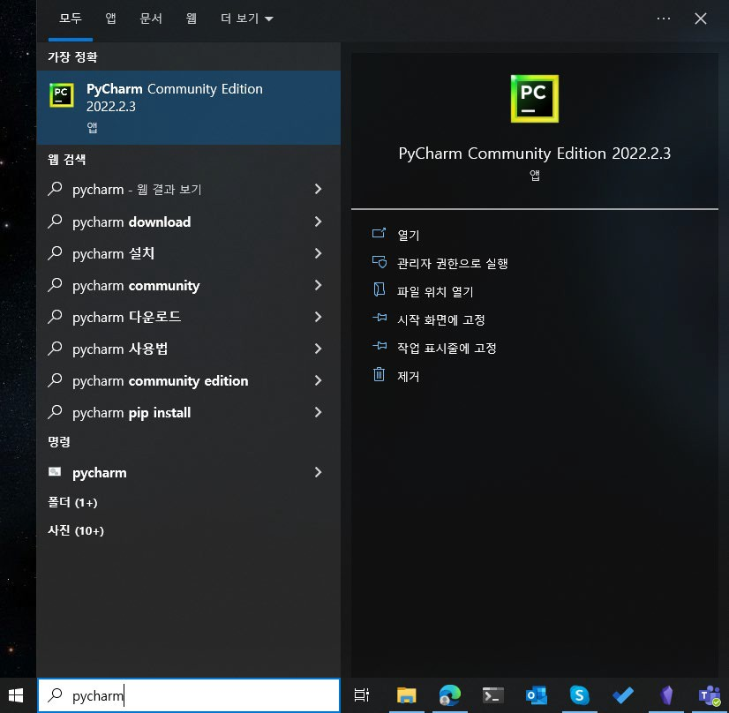
Exercise 4
Launch the Pycharm app
→ Type "Win+q" on your keyboard, then type "pycharm" and click "Open"
→ To install the app, refer to the "Environment Settings" course material!

Slide 75
Exercise 4
Create a Pycharm project and install the library
→ Requires installation of the Python "pyserial" library to proceed with that example
→ For information on how to create a project and install libraries, refer to the "Preferences" course!

Slide 76
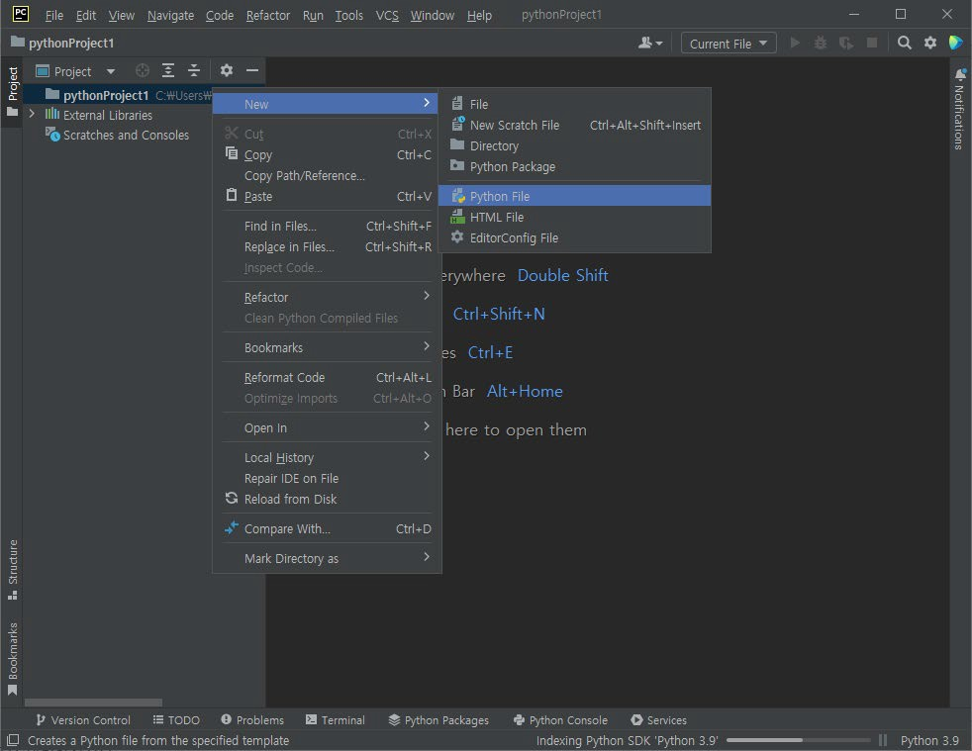
Exercise 4
main.py File Creation
→ Create a main.py file for your project
→ Right-click on the project folder on the left -> select New -> click Python File

Slide 77
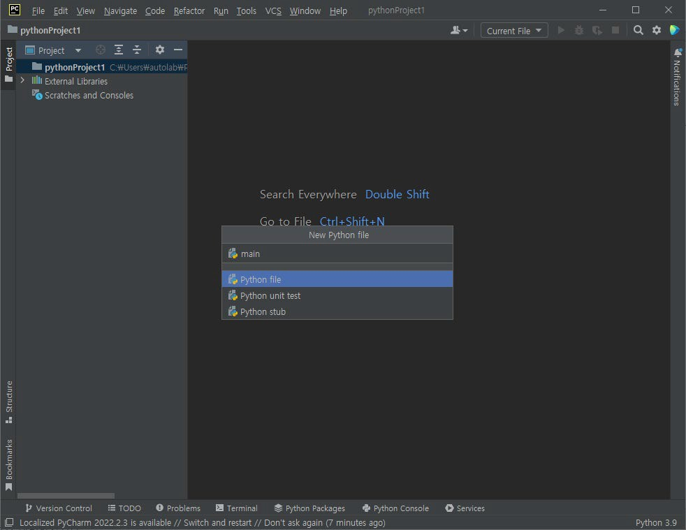
Exercise 4
main.py File Creation
→ Type "main" on your keyboard and then press Enter

Slide 78
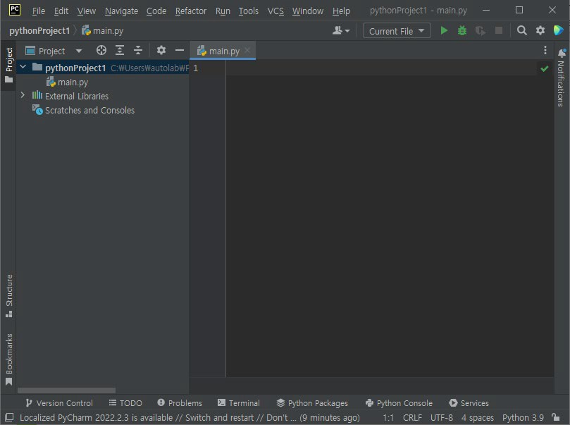
Exercise 4
main.py File Creation
→ Verify file creation “main.py “

Slide 79

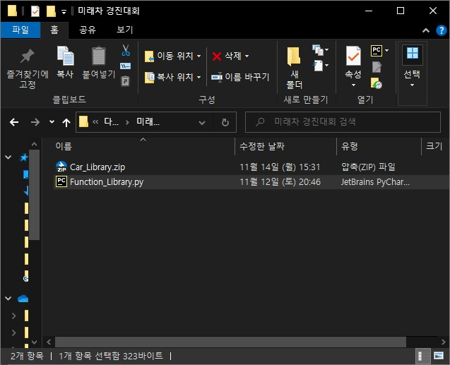
Exercise 4
Function_Library.py Add files
→ Add the "Function_Library.py" downloaded from GitHub to your Python Project
→ Select the file with the mouse and drag and drop it into the PythonProject

Slide 80
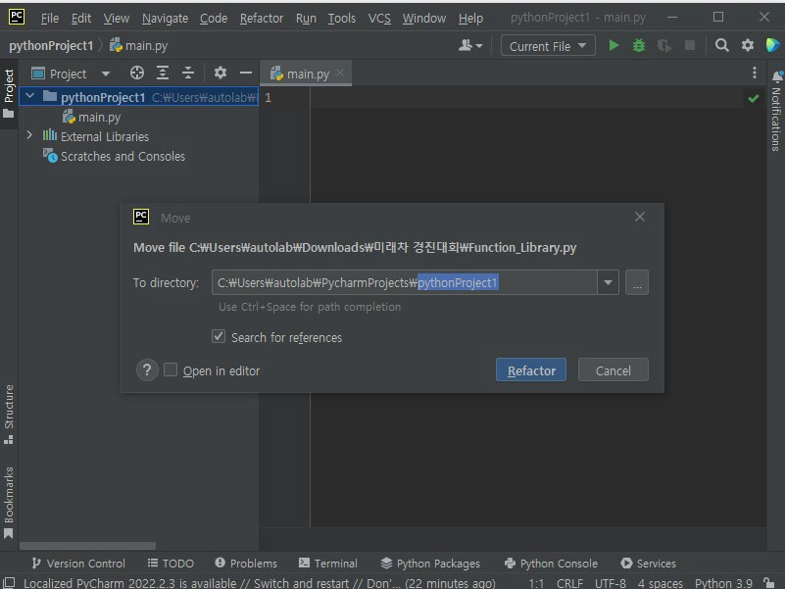
Exercise 4
Function_Library.py Add files
→ When the window appears, press Enter or click the Refactor button

Slide 81
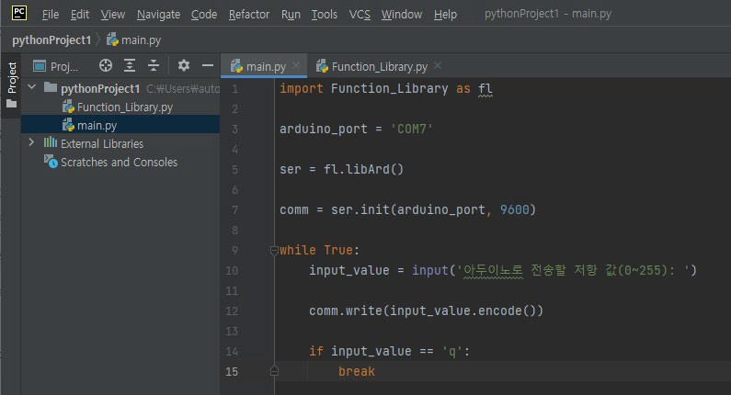
Exercise 4
(Python) Library Import
→ main.py Enter "import Function_Library as fl" in the source code

Slide 82
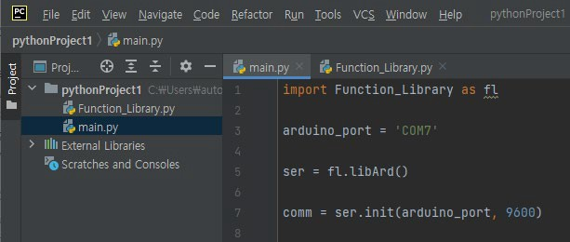
Exercise 4
Declaring variables and loading classes
→ Declare Serial Port Number Variables
→ Load the libArd() class of "Function_Library.py"
→ libArd() class is a collection of functions needed for practice.

Slide 83
Exercise 4
Serial communication settings
→ ser.init() is a function that sets serial port number and sets communication speed in Python
→ Enter the port number variable and communication speed

Slide 84

Exercise 4
Serial communication transmission
→ input(): Output the specified sentence and receive the value input from the user
→ comm.write(): Transmitting input to serial communication

Slide 85

Exercise 4
Arduino Compile and Upload
→ Compare the source code and upload it to the Arduino board

Slide 86

Exercise 4
Running Python source code
→ Click the "Run" button or press Shift + F10 to run the source code
→ Make sure the Arduino serial monitor is closed (if it is open, an error will occur)

Slide 87

Exercise 4
Enter Resistance Values
When you press Run →, a window like the picture will appear at the bottom of the pycharm program.
→ Enter the resistance value you want to send to Arduino and press Enter

Slide 88

Exercise 4
Check the results
→ Check LED brightness changes based on input values

Slide 89
Thank You!
Automation Lab.

Slide 90


Temp – More Problem1
Stopping the servo motor through an ultrasonic sensor (sudden stop)
- Equipment used: , ultrasonic sensor, servo motor
222 mm
125 mm
Motor speed stop when less than 50mm
40 mm
267 mm

Slide 91
Temp – More Problem2
Implementation of a safe start system for child
Equipment used: Variable resistance, ultrasonic sensor
Condition
It is assumed that the seat belt of a baby seat for infants is a tightening method, that is, variable resistance.
Detected by ultrasonic sensors to check if the child is close to the backrest.
Only when the seat belt is tightly fastened in the baby seat and the child is close to the backrest
Motor controllable
The motor control signal uses serial communication.
The motor control signal is activated when "G" is sent as serial communication, and stopped when "S" is sent.

Slide 92


Temp – More Problem2
Case
If your child is safely seated in a baby seat
-> The variable resistance value read is a very large value.
-> The ultrasonic sensor value read is large.
- > LED lights up.
-> Send a motor control signal to control the motor.
Other cases
-> The LED lights out.
-> Even if the motor control signal is sent, the motor cannot
-> If the motor is running, stop immediately.
chair
Ultrasonic sensor (backrest)
child
b _{V} trolled.
e con
ariable
Resistance (Belt)

Slide 93
Temp – More Problem3
Rotating the motor by the angle of variable resistance=Readjust the variable resistance to a value between 0~255 to a value between -5 0 5 (Negative - Reverse / Positive - Forward / 0 – Stop)
0 ~ 255
-5 ~ 5
Accelerate as the absolute value of the variable resistance increases
(0→-1 acceleration, 0→3 3x acceleration)

